Slide 1
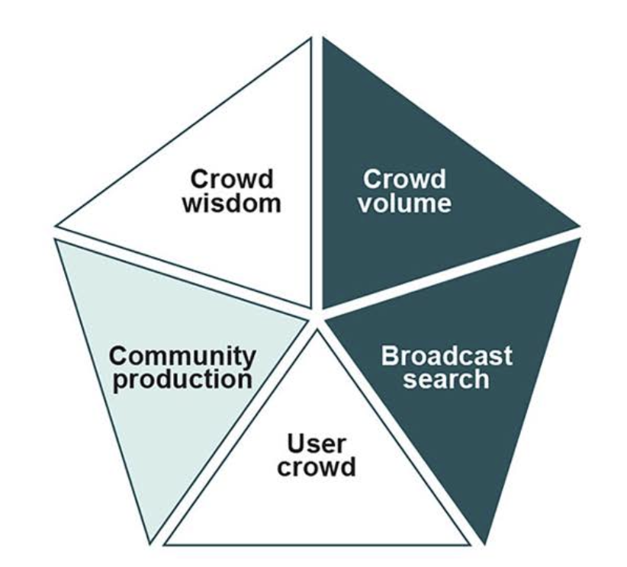
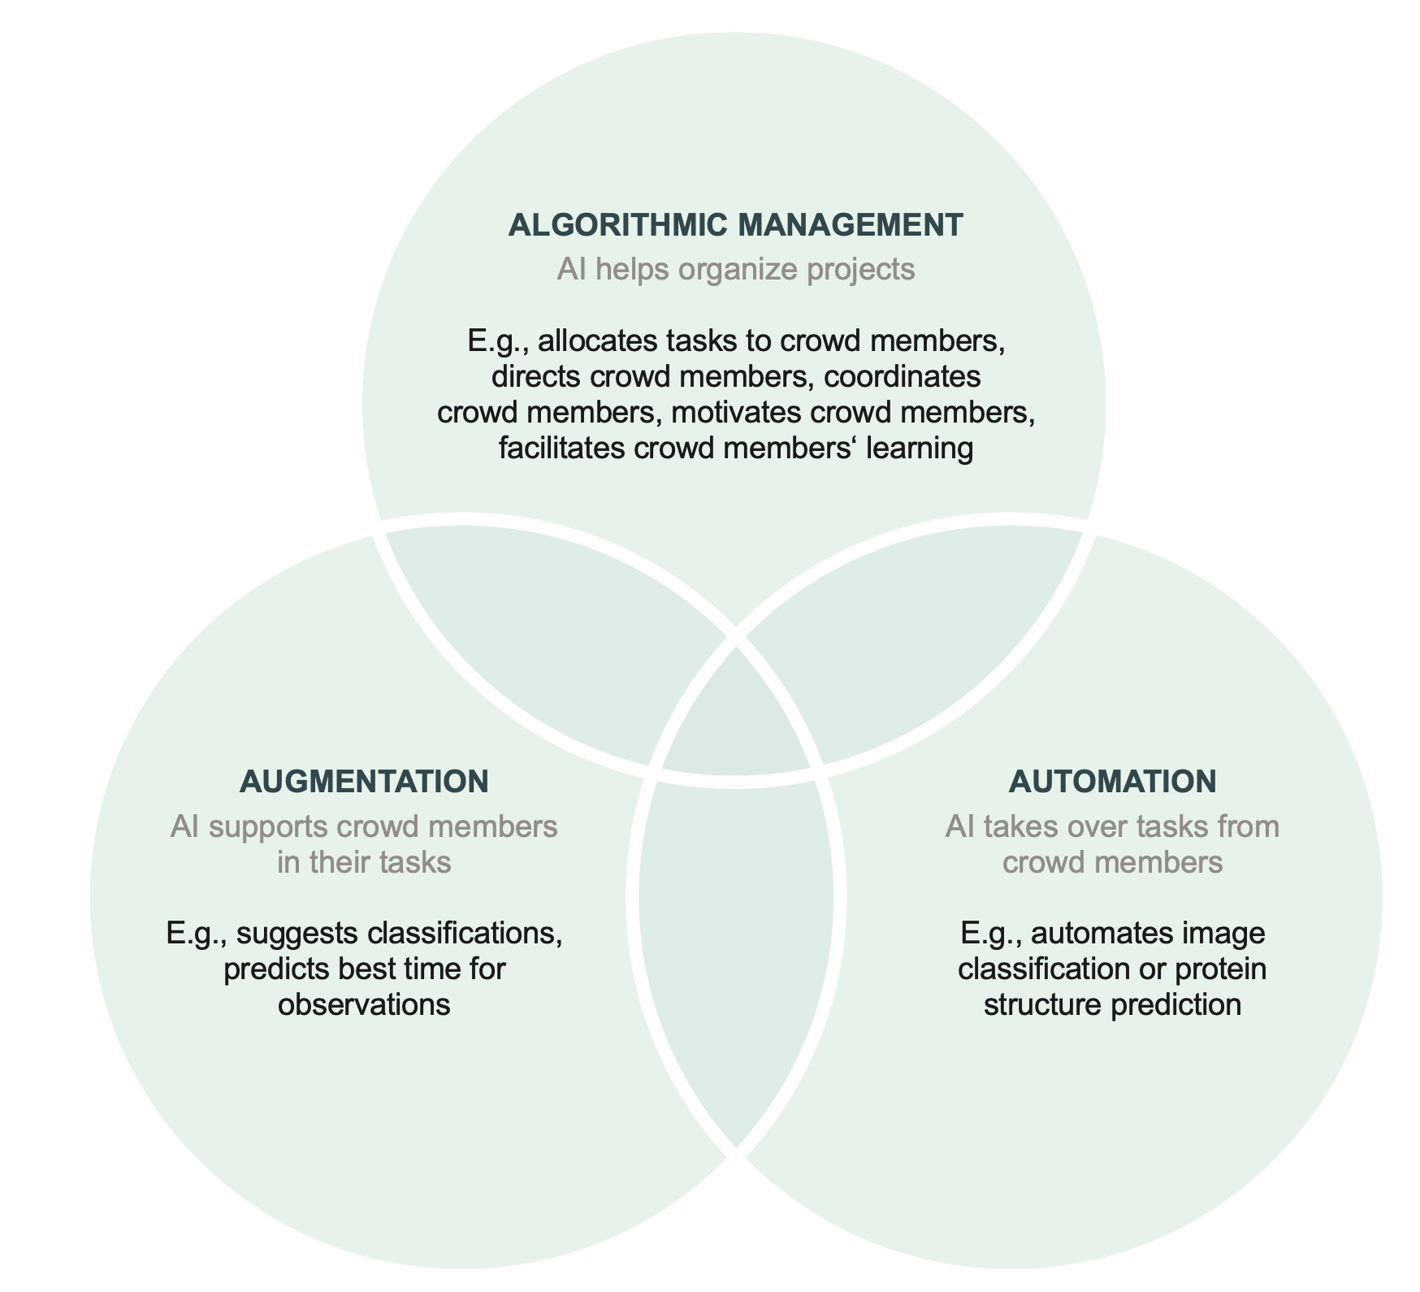
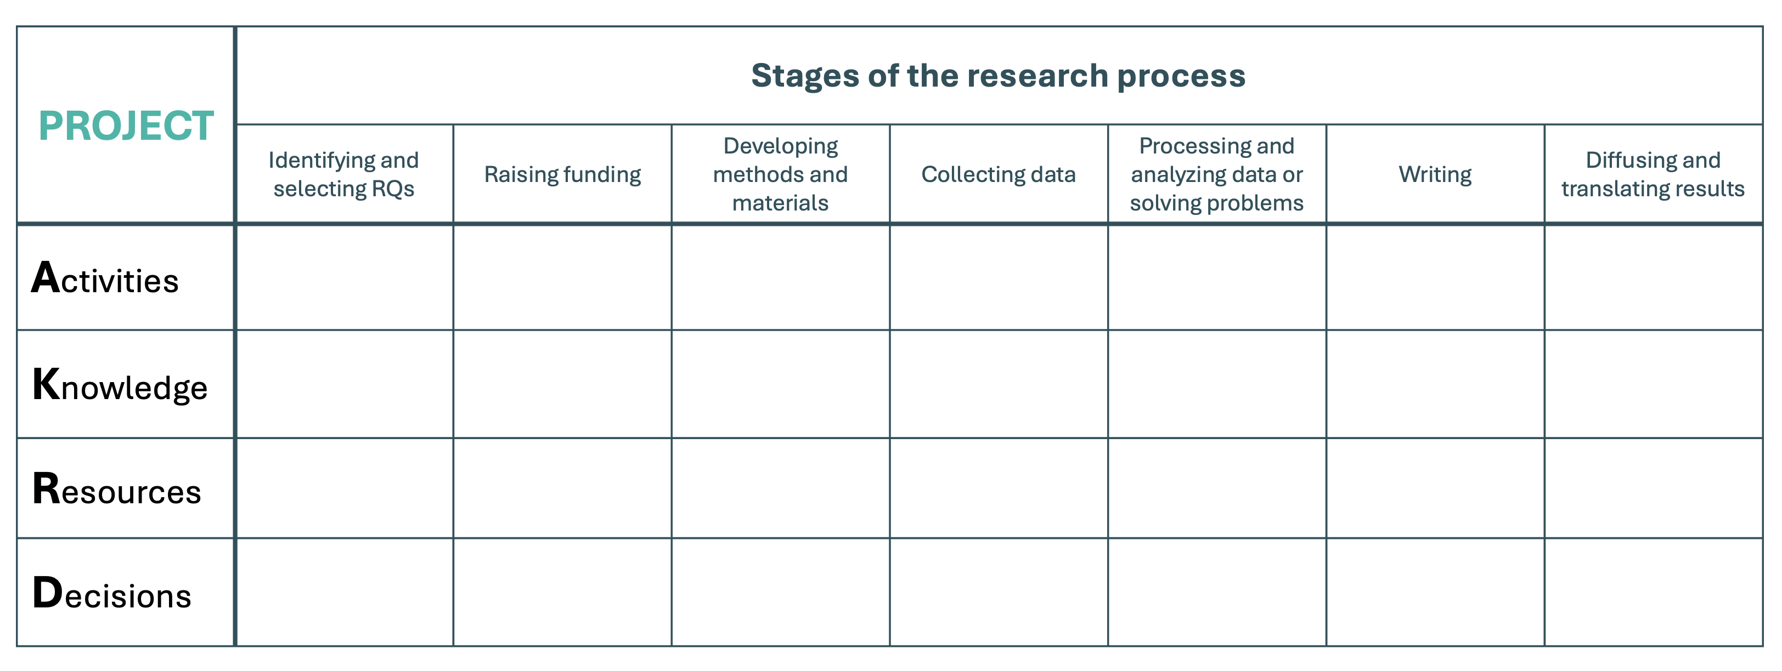
Group work: Analysis of existing/design of new crowd science projects
In groups, please select and analyze/design a crowd science project* (worksheet 1 and 2):
Why was (is) crowd involvement beneficial - Crowd Science Paradigms?
Who was (is) the crowd? Crowd Characteristics
What did (will) the crowd contribute - AKRD Crowd Contribution Matrix?
Where and how did (could) AI (have) help(ed)?
*use own existing (or planned) project, or pick a project you know about!
Notes:
Marion

Slide 2



Why crowd involvement has benefits: The Crowd Science Paradigms
Aggregating independent knowledge and preference inputs from many crowd members can mitigate individual-level errors and biases (e.g., Galaxy Zoo – Zooniverse project).
A crowd of contributors supplies a high volume of effort or other inputs, potentially across different locations (e.g., Galaxy Zoo – Zooniverse project).
Crowd wisdom
Crowd volume
Interactions among crowd members or between crowd members and researchers allow the recombination of complementary knowledge, preferences, and other inputs to address complex problems (e.g., Epidemium).
Community production
Broadcast search
Broadcasting a problem or call for inputs to the crowd helps identify individual outlier solutions or other rare inputs (e.g., Foldit)
User crowd
Users have experiential knowledge or other use-related inputs that professional scientists lack (e.g.,
Tell Us! About Accidental Injuries).
Notes:
Henry

Slide 3
Worksheet 1: Insert name of selected project
1. Why was (is) crowd involvement beneficial?
2. Who was (is) the crowd?
→ Highlight which paradigm/s is/are very and somewhat relevant
Insert analysis of relevant crowd characteristics
Crowd wisdom
Crowd volume
Community production
Broadcast search
User crowd
Notes:
Henry

Slide 4
What the crowd contributes: The AKRD Crowd Contribution Matrix
PROJECT | Stages of the research process
 | Identifying and selecting RQs | Raising funding | Developing methods and materials | Collecting data | Processing and analyzing data or solving problems | Writing | Diffusing and translating results
Activities
Knowledge
Resources
Decisions
What concrete activities do contributors perform?
What kinds of knowledge do contributors require and utilize (e.g., general, expert, experiential, …)
What kinds of resources do contributors share or need in order to participate?
What kinds of decisions do contributors make or participate in making?
See also, Franzoni, Poetz and Sauermann (2022)
Notes:
Marion

Slide 5
Worksheet 2: Insert name of selected project
3. What did (will) the crowd contribute? 4. If time, where and how did (could) AI (have) help(ed)?
 | Stages of the research process
 | Identifying and selecting RQs | Raising funding | Developing methods and materials | Collecting data | Processing and analyzing data or solving problems | Writing | Diffusing and translating results
Activities
Knowledge
Resources
Decisions
Notes:
Marion

